Slide 1
Operating Systems
Course #9 Deadlocks
Răzvan Daniel ZOTA
Faculty of Cybernetics, Statistics and Economic Informatics
zota@ase.ro
https://zota.ase.ro/os

Slide 2
Deadlocks
What is a deadlock?
“A deadlock is a state in which, each member of a group of actions, is waiting for some other member to release a lock”
Two (main) approaches:
“safe”: prevent and avoid deadlocks
“dangerous”: it enables a deadlock appearance, then detect it and solve the problem

Slide 3
Deadlocks
Examples:
“It takes money to make money".
You cannot have a job without experience; you cannot have experience without a job.
Deadlock causes: each process needs an output form other process.
This fact has the result of resource sharing (memory, equipment, connection links, etc).
In a normal situation, the operation of resource allocation is done like this:
The resource is demanded.
The resource is used.
The resource is freed-up.

Slide 4
Example: crossing a bridge
One direction only traffic.
Each section of the bridge can be considered as a resource.
If a deadlock occurs, it can be solved if one of the cars goes back (resource preemption).
It can appear the phenomenon of “starvation”.
See also the 5 philosophers problem: (http://en.wikipedia.org/wiki/Dining_philosophers_problem)

Slide 5
Deadlock characteristics
Necessary conditions
All 4 conditions must happen simultaneously in order to have a deadlock:
Mutual exclusion
One or more resources must be owned by a process in an exclusive way.
“Hold and Wait”
A process owns a resource while is waiting for another resource to be freed-up.
No preemption
We have only the possibility that a resource is freed-up voluntarily – nothing else can force to freed-up the resource.
Circular waiting
The process A waits for process B that waits for process C .... that waits for A.
Notes:
http://www.personal.kent.edu/~rmuhamma/OpSystems/Myos/deadlockCondition.htm

Slide 6
Resource allocation graph
A graph can be used to visually determine the appearance (or the possibility of appearance) of a deadlock.
G = ( N, L ) nodes (vertices) and links (edges)
N The nodes are processes= {P1, P2, P3, ...} and different types of resources {R1, R2, ...}
L The links are ( Pi, Rj ) or ( Ri, Pj )
An arrow from one process to a resource means that the process needs that resource.
An arrow from a resource to a process means that an instance of that resource has been allocated to that process.
In the drawing, the process is a circle, the resource is a square; the dots are representing the number of instances for that specific resource.

Slide 7
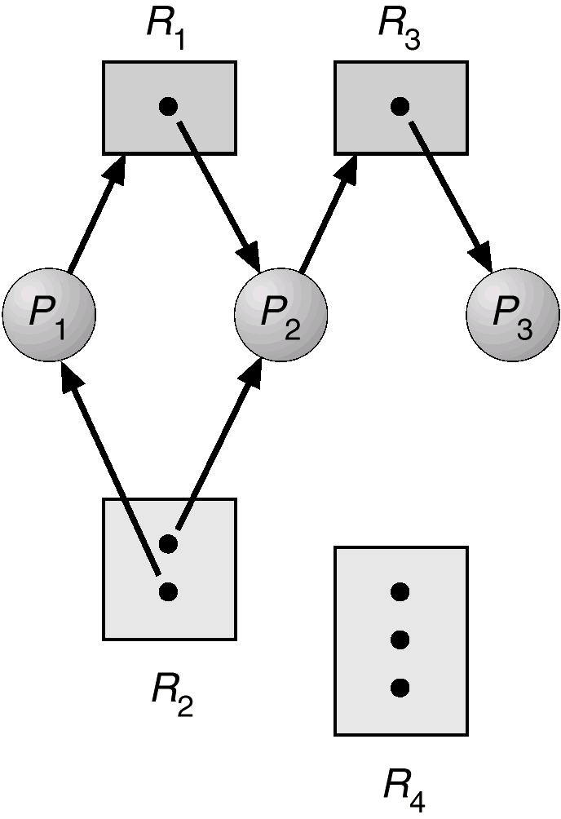
Resource allocation graph
If the graph has no cycles, no process is blocked.
If there is a cycle, then:
a) If the types of resources have more instances, then it MIGHT exist a deadlock.
b) If every type of resource has a single instance, a deadlock will appear.
Resource allocation graph
R3 assigned to P3
P2 requests R3

Slide 8
General strategies for approaching deadlocks
In general, there are three approaches for dealing with deadlocks:
- Ignoring deadlocks.
- Assuring the fact that a deadlock can never appear:
Prevention Preventing the appearance of one of the four conditions (Mutual exclusion,“Hold and Wait”, No preemption, Circular waiting).
Avoidance The deadlock conditions are enabled but the appearance cycles are computed and the dangerous operations are stopped.
- Enabling the deadlock appearance. In this case there are used the following:
Detection The moment when a deadlock has appeared is known.
Recovery The resources are “recovered”.

Slide 9
Preventing deadlocks
None of the four conditions cannot appear
Mutual exclusion:
a) It is automated for printers and other non-sharable devices
b) Entities like read only files don’t need mutual exclusion, because they cannot lead to deadlocks.
“Hold and wait”:
a) All the resources are gathered before the execution
b) One particular resource can be demanded only when nobody holds it. In a sequence of resources the first one is demanded first.
c) In this case, “starvation” may occur.

Slide 10
Preventing deadlocks
No preemption:
a) Any assigned resource is freed-up if the process cannot obtain another resource.
b) If a resource is assigned to a process involved in a waiting state for another resource, this is “stolen”.
Circular waiting:
a) The resources are numbered and their demand is done in ascending order
b) Each of the preventing methods can lead to a low resource utilization. For this reason, prevention is not necessarily the best method to implement.
c) Prevention is the easiest method to implement

Slide 11
Deadlock avoidance
If we can know from he beginning the way of using resources, it’s possible to determine if an “unsafe” state may appear.
The possible states are the following:
Deadlock Nothing “constructive” can be done furthermore
Unsafe state A state for which a deadlock may occur
Safe state A state is safe if there is a sequence of processes such as there are enough resources for the first process to finish and each process is finishing and freeing the necessary resources for the next process to finish.
A simple rule may be: “if a resource demand allocation may lead to an unsafe state, don’t satisfy that demand”.
Obs. All the deadlocks are unsafe, but not all unsafe states are deadlocks

Slide 12
Process concurrency in Unix/Linux
The UNIX/Linux world offers some mechanisms for communication and synchronization between processes:
Pipes
Messages
Shared memory
Semaphores
Signals

Slide 13
Process concurrency in Unix/Linux
Pipes – a pipe represents a circular buffer that enables the communication between two processes using the “producer-consumer” pattern – a FIFO queue where a process sends a message to another process. When a pipe is created, it has a fixed dimension in bytes.
When a process tries to write in the pipe the writing demand is immediately executed (if there is enough space, otherwise the process is blocked). In the same way, a process that needs a reading operation is blocked if it tries to read more octets than are existing in the pipe – on the contrary, the reading demand is immediately executed.
The OS applies mutual exclusion in this case – only a single process may access the pipe at one moment in time.

Slide 14
Process concurrency in Unix/Linux
Messages – A message is a block of text of a certain type. The OS uses the system calls msgsnd and msgrcv to transfer messages. Each process has a message queue that is working as a mailbox.
Shared memory – represents (in Unix/Linux) the quickest form of communication between processes. There is a common virtual memory block shared between multiple processes.
The processes are reading from or writing in the common memory space using the same instructions used for reading/writing from/to the virtual memory.
The permissions are read-only or read-write for each process.
The mutual exclusion is assured by the processes that are using the shared memory.

Slide 15
Process concurrency in Unix/Linux
Semaphores – represent a generalization of the system primitives wait and signal. The kernel is doing all the operations one by one and no process cannot access the semaphore till all operations are fulfilled.
Signals – a signal is a software mechanism that informs a process about the appearance of an asynchronous event. A signal is similar with a hardware interrupt but it doesn’t implies priorities (all signals are considered “equal”). The signals that appear in the same time are presented to a process one by one, without an order based on priorities.
The processes can send signals to other processes or the signals are sent by the kernel. A signal is delivered by updating a field in the (receiving) process table.

Slide 16
Read InformIT articles!
On InformIT.com you may find interesting articles from any IT field !
Here you find an Introduction to Operating System Deadlocks:
https://www.informit.com/articles/article.aspx?p=25193

